Slide 1
Metric Learning: A Survey
Yijun Liu
Department of Computer Science
University of Wyoming
Kulis, Brian. "Metric learning: A survey." Foundations and Trends® in Machine Learning 5.4 (2013): 287-364.

Slide 2
Introduction
Linar Models for Metric Learning
Nonlinear Models for Metric Learning
Extensions
Application

Slide 3
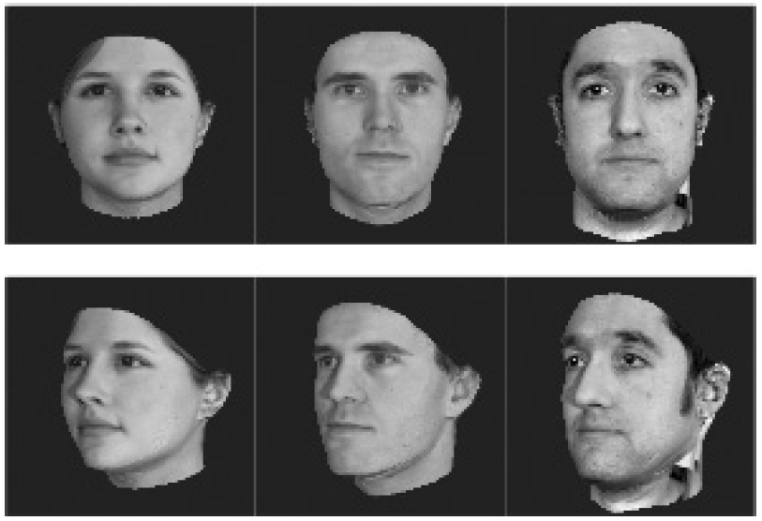
Background
Consider the images below, and imagine a situation in which we must compute similarity or distances over pairs of images (for example, for clustering or nearest neighbor classification). A basic question that arises is precisely how to assess the similarity or distance between the pairs of images.
A desirable way and the focus of this survey is to apply metric learning
Fig. 1.1 Example face data set. In one application, our notion of “distance” between faces may depend on the pose, whereas in another application it may depend on the identity.

Slide 4
Metric learning
A possible informal formulation of the metric learning problem:
1). Given an input distance function d(x,y) between objects x and y.
2). Construct a new distance function D(x,y) which is “better” than the original distance function.
3). This survey will focus, for the most part, on learning distance functions D(x,y) of the form d(f(x),f(y)) for some function f. We learn some mapping f and utilize the original distance function over the mapped data.

Slide 5
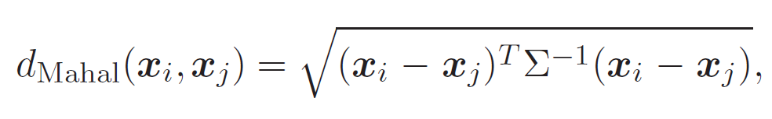

Linar Models for Metric Learning
Let us suppose that we have a set of data points in a Euclidean space x1, . . . ,xn. Let X = [x1, . . . ,xn] be the matrix of all the data points.
The Mahalanobis distance is defined as the following:
Where Σ is the covariance matrix of the data
In the metric learning literature, the term “Mahalanobis distance” is often used to denote any distance function of the form:

Slide 6
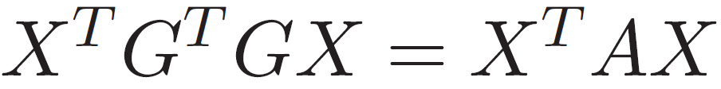
Linar Models for Metric Learning
In the case of global linear metric learning, the learned distance is the squared Euclidean distance after applying the transformation G globally.
Supervision based on the mapped Euclidean or squared Euclidean distance since

Slide 7
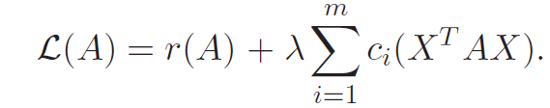

Objective Function
We assume that we are given a collection of m loss functions, which we will denote as c₁, . . . ,c_{m}; each loss function depends on the data only through the inner product matrix X^{T}AX.
The second part of the model is a regularizer on the model, which we will denote as r(A).
A linear combination between these two components of the model:
The λ term is a trade-off between the regularizer and the loss. The goal will be to find the minimum of .

Slide 8
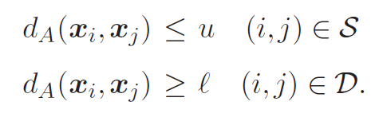
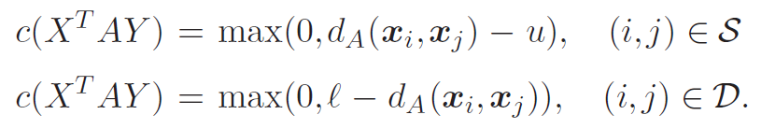
Constraints
Before discussing some specific examples of model, let us briefly consider regularization and supervision in a general setting. The two most popular forms of supervision for metric learning are given by similarity/dissimilarity constraints and relative distance constraints.
1) similarity/dissimilarity constraints
We can encode these as loss functions in various ways
hinge loss

Slide 9


Constraints
2) relative distance constraints
Typically, these are specified via a triple (i, j,k) ∈ R which denotes that x_{i} should have a smaller distance to x_{j} than x_{i} to x_{k}:
Or adds a margin to the above constraint

Slide 10
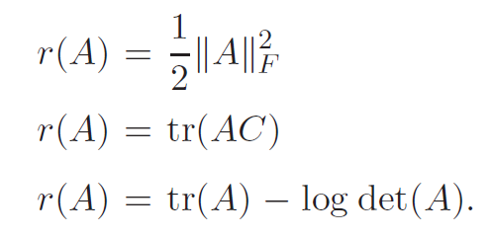
Regularizers
Regarding regularizers, we will motivate several cases in the examples below.
The particular choice of regularizer has a significant impact on the resulting metric learning model. For instance, when C is the identity matrix, the resulting regularizer is the trace-norm regularizer, which is known to prefer low-rank solutions.

Slide 11


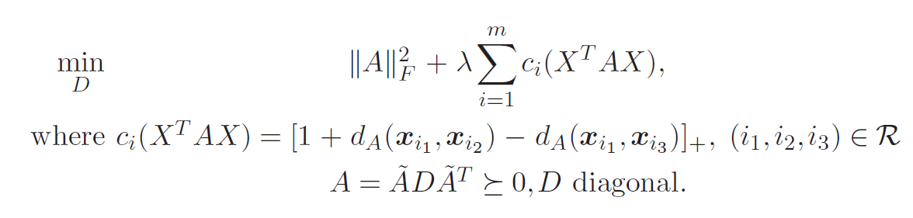
Model of Schultz and Joachims
More formally, Schultz and Joachims consider learning a Mahalanobis matrix A of the form , where D is a diagonal matrix and is a given (possibly non-diagonal) matrix. Then the optimization is expressed in terms of D as
Here R is a set of relative distance constraints.
Learning a diagonal Mahalanobis matrix is equivalent to simply learning weights on the features.

Slide 12
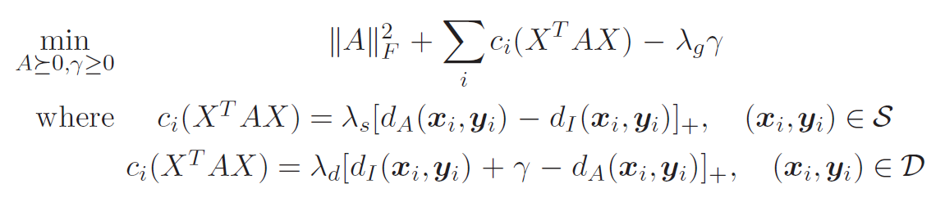
Model of Kwok and Tsang
In follow-up work, Kwok and Tsang presented a method that uses Frobenius regularization and similarity/dissimilarity constraints.
d_{A} is the learned distace. d_{I} is the original distance.

Slide 13
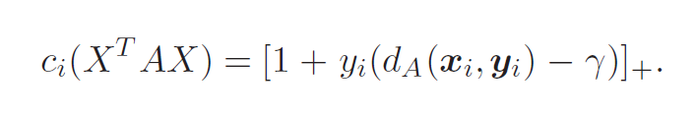
Pseudo-Metric Online Learning Algorithm
The POLA algorithm is an example of a Frobenius-regularized Mahalanobis metric learning method applied in the online setting.
Let y_{i} = 1 if the pair of points for constraint i, (x_{i},y_{i}), should be similar, and y_{i} = −1 if the pair should be dissimilar. The following loss functions are used by POLA:

Slide 14
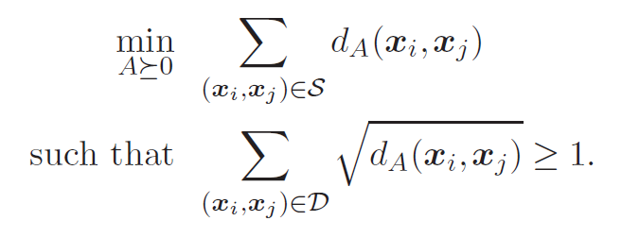
Metric Learning for Clustering
Minimizing the sum of distances that should be similar.
Maximizing the sum of distances that should be dissimilar.

Slide 15
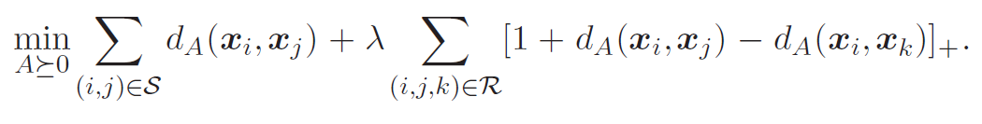
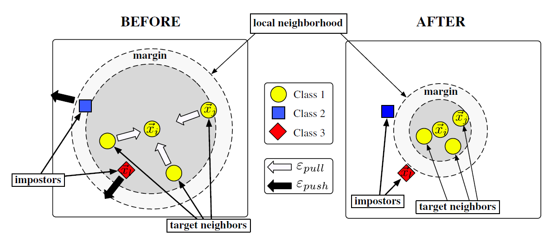
Large-Margin Nearest Neighbors (LMNN)
The regularizer of this method is tr(AC)
Data points of same labels should be near from the given point
Data points of different labels should be far from the given point.
Fig. 2.1 The goals of LMNN.

Slide 16
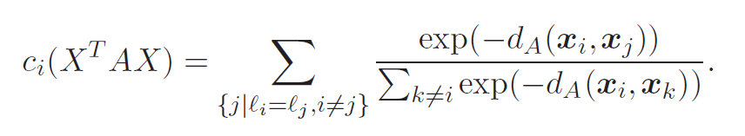
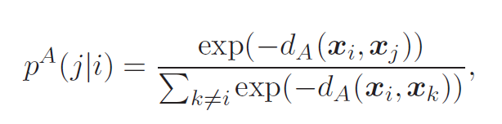
Neighbourhood Components Analysis (NCA)
The main idea behind these objectives is to optimize a softmax version of the leave-one-out KNN score. where there is no regularizer, and n constraints of the form:
Define the NCA objective as a set of conditional probabilities p^{A}(j|i), defined as
The NCA objective aims to find the matrix A that maximizes p^{A}(j|i) summed over all i.

Slide 17
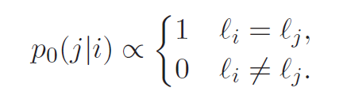
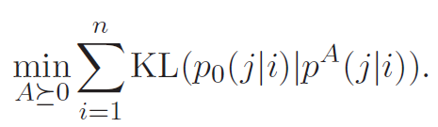
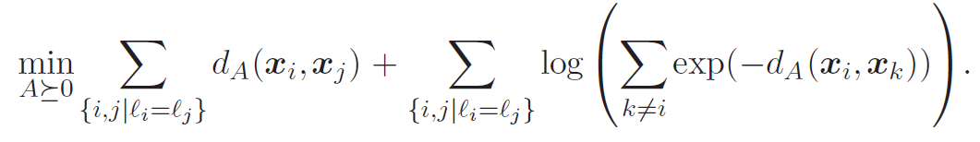
Maximally Collapsing Metric Learning (MCML)
In contrast, the MCML objective aims to minimize the KL-divergence between p⁰ and p^{A}:
We can simplify the objective as follows:

Slide 18
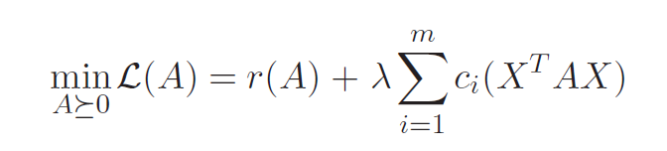
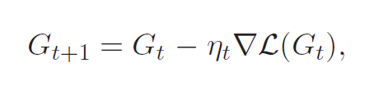
Optimization Techniques
Gradient Descent
For instance, an optimization of the form:
Proceeds by iteratively computing the gradient of L with respect to G and moving in the direction of the gradient:

Slide 19
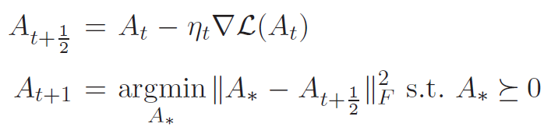
Optimization Techniques
On the other hand, if our model is convex and we would like to retain
convexity, we can apply the projected gradient method
The first step is the standard gradient descent step, and the second step is the projection back to the cone of positive semi-definite matrices.

Slide 20
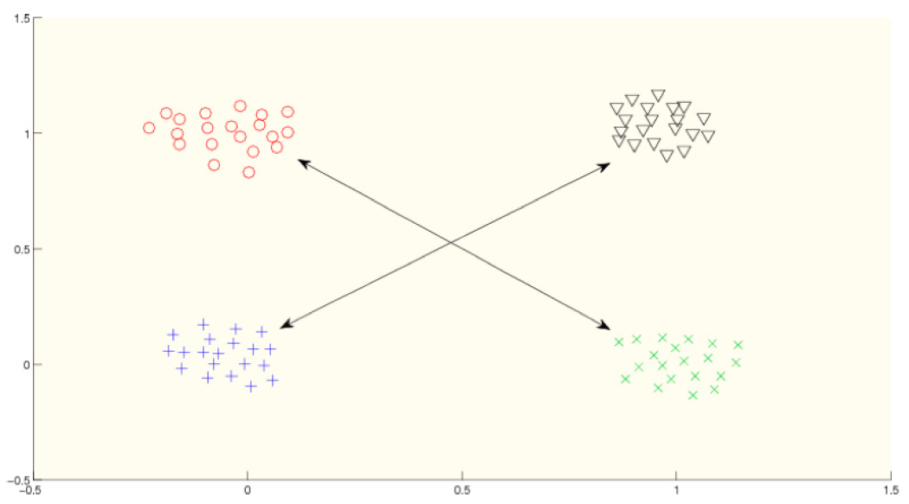
Nonlinear Models for Metric Learning
Fig. 3.1 Example of the limitation of linear methods. Suppose in this data we would like that the black and blue points should be “similar” to one another, while the red and green point should also be similar to one another (while simultaneously the black and blue points should be dissimilar to the red and green points). No global linear metric will suffice for enforcing the constraints.

Slide 21
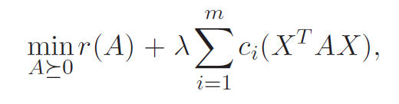
Kernelization of Linear Methods
Recall the linear model discussed in the previous section:
(2.1)
where r is the regularizer and c_{i} are the loss functions. Optimizing this model generally require updating A iteratively, using the data points from X directly.
Only require access to inner products x^{T}_{i} x_{j} between data points. We can generalize the resulting algorithms to utilize kernel functions instead of inner products.

Slide 22
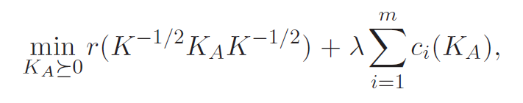
Kernelization of Linear Methods
That is, we will re-write the optimization problem with respect to the kernel matrix
K = X^{T}X, and once we have the kernel matrix we will not require the original matrix X.
This permits the use of kernel functions to form kernel matrices after applying nonlinear mappings to the original data.
More specifically, we will consider the following problem:
(3.1)

Slide 23
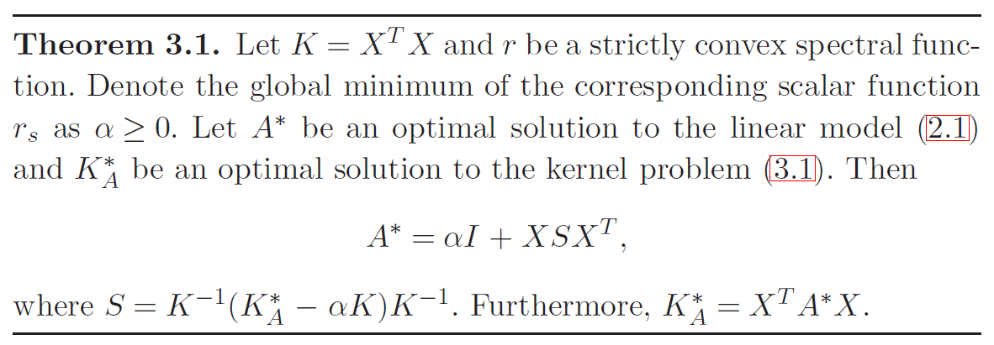
Kernelization of Linear Methods
When we instead solve (3.1), we obtain K_{A,} not A. We can simply compute the mapped inner product x^{T}Ay using an implicit representation of A using K_{A} and kernel evaluations, as follows:
S is obtained from K and K_{A}

Slide 24
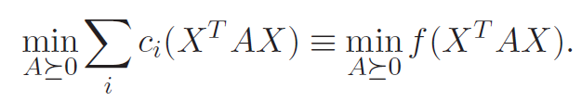

The Kernel PCA Trick
We simply apply kernel PCA to the data and run the same algorithm for the linear model on the transformed data. This is guaranteed to find the optimal solution to the kernel form of the metric learning problem,
Theorem 3.1 above says that A has a representation A = XSX^{T}. Thus we could equivalently write the problem as

Slide 25
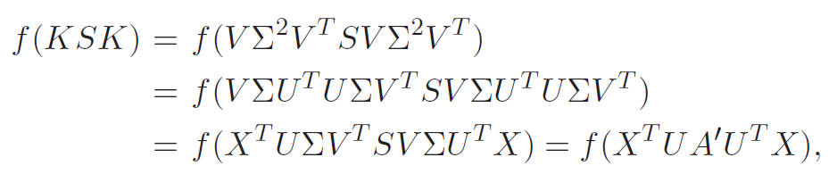


The Kernel PCA Trick
Now, let us denote the SVD of X as X = UΣV^{T} . The kernel matrix is expressed as K = VΣ²V^{T} , and we have
where A' =ΣV^{T}SVΣ. Thus we can equivalently write the optimization in terms of A' :
We also note that, if A is the optimal solution to the linear metric learning problem, then

Slide 26

The Kernel PCA Trick
Putting these two observations together, we can equivalently run the metric learning problem on X' = U^{T}X to produce a matrix A'. Then, the learned distances are computed via learned inner products
The data X' is simply the original data projected onto the eigenvectors of the covariance matrix.
Given original data X, compute X' by projecting onto the eigenvectors of the covariance with non-zero eigenvalues (via the approach used by kernel PCA).

Slide 27
Other Nonlinear Methods
Non-Mahalanobis Local Distance Functions
A major drawback to global Mahalanobis metric learning is that one learns a single transformation to be applied across the entire space globally. they
propose to learn a distance per training point.
Mahalanobis Local Distance Functions
The idea is to learn a Mahalanobis matrix per class.
Metric Learning with Neural Networks
These networks are multi-layer, nonlinear systems, and produce a mapping from the input space to some nonlinear transformed space.

Slide 28
Extensions
The simple approach of applying metric learning for a nearest neighbor classification problem is not always the whole story.
1). Metric Learning for Kernel Regression
2). Metric Learning for Ranking
3). Dimensionality Reduction and Data Visualization
4). Database Indexing
5). Domain Adaptation

Slide 29
Application
Applications of metric learning is employed in various domains.
1). Computer Vision
2). Image Retrieval and Classification
3). Face Recognition
4). Human Activity Recognition and Pose Estimation
5). Text Analysis
6). Music Analysis
7). Automated Program Debugging
8). Microarray Data Analysis

Slide 30
Thank you

